Slide 1
KANBAN for development
Presented by
Dmitro Malikov

Slide 2
KANBAN for development
KAN
+
BAN
+
署名する
ボード
=
“signboard”
Notes:
Kanban is a method for managing knowledge work which balances demands for work with the available capacity for new work. Work items are visualized to give participants a view of progress and process, from task definition to customer delivery. Team members "pull" work as capacity permits, rather than work being "pushed" into the process when requested.
In software development, Kanban provides a visual process-management system which aids decision-making about what, when and how much to produce

Slide 3
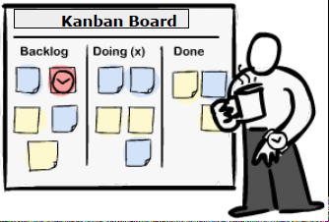
Kanban - 3 basic principles
1. Start with what you do now
● Kanban does not prescribe a specific set of roles
or process steps
2. Agree to pursue incremental, evolutionary change
● continuous small changes that stick vs. sweeping changes that fail due to resistance
and fear in the organization
3. Respect the current process, roles, responsibilities &
titles
● gain support, reduce fear/resistance to change and experience the benefits as a team

Slide 4
Kanban - 5 Core Properties
1. Visualize the workflow
● Kanban literally means "signboard" or "billboard"
2. Limit Work In Process (WIP)
● use a pull system - establish and respect your ideal
capacity
3. Manage Flow
● monitor, measure and report the flow of work through each state
4. Make Process Policies Explicit
● describe the process accurately in order to improve it
5. Improve Collaboratively
● using models & the scientific method (empirical) to implement continuous, incremental and
evolutionary changes

Slide 5
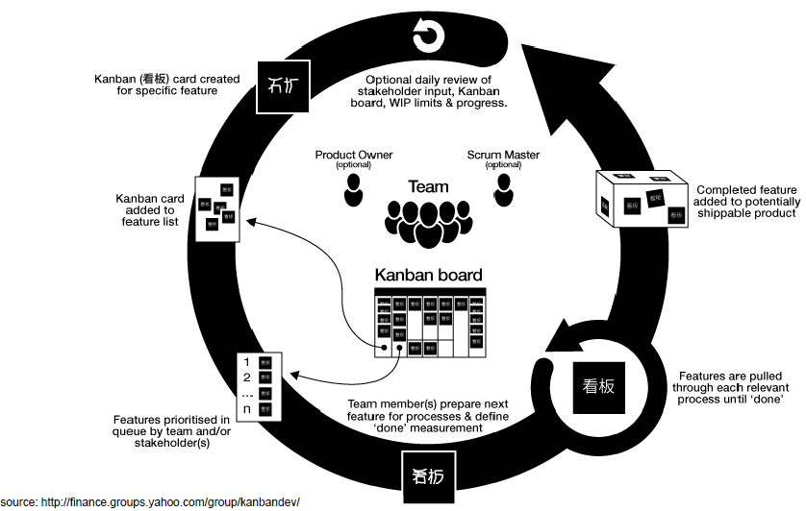
KANBAN for development

Slide 6
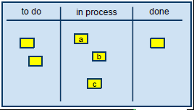
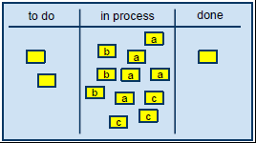
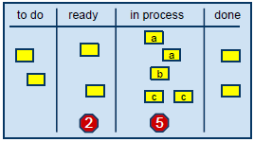
KANBAN - start
Start with a simple task board with 3 columns: to do, in process and done.
Each card represent a work item in the current scope. Names can be associated with
the cards.
The key is to setup an easy way to visualize the work, and create an area for social
interactions.
A problem with such a simplistic board, is the lack of rules and the concept of timeboxing.
A typical problem is accumulating too much work in progress (WIP).
Kanban is more than just adding work items on a board, it's also applying a PULL
process.
To truly embrace Kanban, we must regulate the volume of cards on the board. This
can easily be accomplished by identifying clear thresholds associated to better
defined stages of work (columns).
Another improvement is to set a multi-tasking limit per user (2) and using late binding
of tasks to owners. Note that not all team members must have 2 tasks with their
names, this is a maximum of 2.

Slide 7
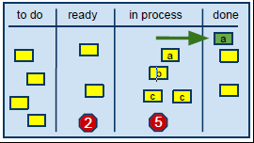
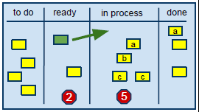
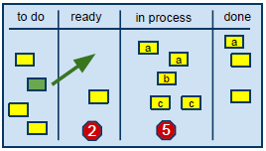
KANBAN - mechanics
1. Team member A completes a card
and moves it to the "done" column.
2. Team member A pulls a new card
from the "ready" column and starts
working on it by placing it in the "in
process" column.
3. The team responds to the pull
event and selects the next priority
card by moving it to the "ready"
column.

Slide 8
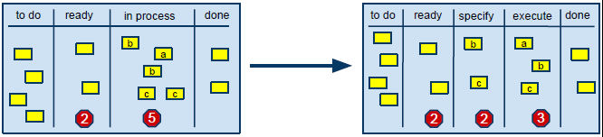
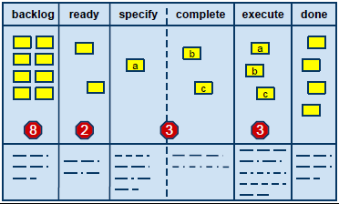
KANBAN - flow
Now that we have established our team capacity and we have a pull system, we can streamline the ideal flow.

